Slide 1
THE EVOLUTION OF INDIA’S SCIENCE,TECHNOLOGY AND PUBLIC POLICY:
Lupin Science Park
Science Day
February 28, 2017
DR. S. SIVARAM
Email : s.sivaram@iiserpune.ac.in
www.swaminathansivaram.in

Slide 2
OUTLINE
The epochal events of February 28
Science in pre-independent India
Origins of modern scientific enterprise
Science in the 21st century
Science in Independent India : Evolution of public policies
Science in contemporary India

Slide 3
The epochal events of February 28

Slide 4
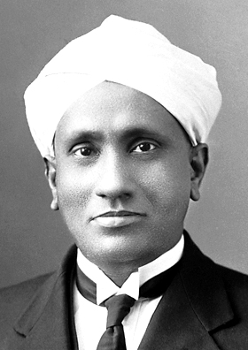
“We have got a young student with fine intellect, doing research in our laboratory. A side issue of his work has been published in Nature (24 Oct, 1907). The prophecy of the great man (MLS) is now going to be fulfilled. If circumstances do not go against us, Raman will be the brightest ornament of IACS.”
A.L Sarkar, son of Mahendra Lal Sarkar, founder of IACS, 21 November 1907
C. V. Raman
7 November 1888 - 21 November 1970
1906 Stood 1st in M.Sc (did not attend classes!!)
Assistant Auditor General, AG`s Office, Calcutta
1907 Starts research at IACS, part time and publishes the first paper
“Indian mind is not inferior ; what we lack is courage and a spirit of victory. If that indomitable spirit were to arise, nothing can hold us from achieving our rightful destiny”

Slide 5
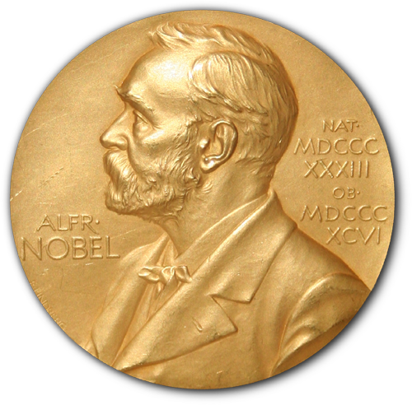
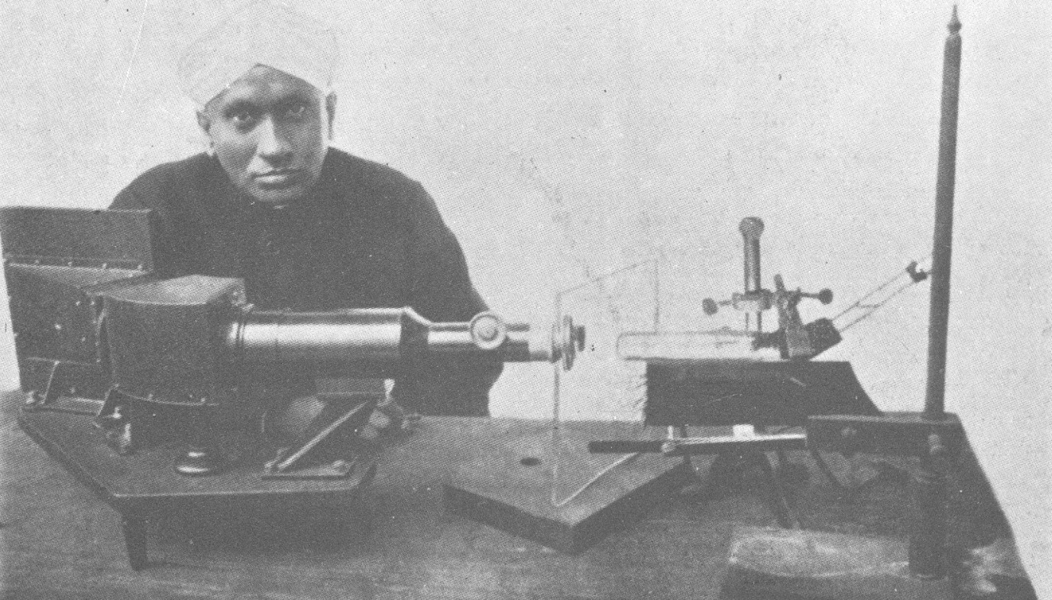
THE RAMAN EFFECT
On February 28, 1928, through his experiments on the scattering of light, Raman discovered a phenomena called Raman Effect
Raman was supremely confident of winning the Nobel Prize in Physics. He was disappointed when the Nobel Prize went to Richardson in 1928 and de Broglie in 1929. He was so confident of winning the prize in 1930 that he booked tickets in July, even though the awards were to be announced in November, and would scan each day’s newspaper for the announcement, tossing it away if it did not carry the news. He did eventually win the 1930 Nobel Prize in Physics "for his work on the scattering of light and for the discovery of the effect named after him ’’. He was the first Asian and first non-white to get a Nobel Prize in the sciences.

Slide 6
ASUTOSH MUKHERJEE ON RAMAN’S SACRIFICE
“I admire the courage and spirit with which Raman exchanged a lucrative official appointment for a university professorship. This instance encourages me to entertain the hope that there will be no lack of seekers of truth in the Temple of Knowledge which it is our ambition to erect.””
“ Sir Asutosh ventured to ask an young and unknown official to devote himself to the pursuit of knowledge under the aegis of the Calcutta University. This, on his part, was an act of courage. But for the action of Sir Asutosh, my scientific career would long ago suffered an abrupt termination.”
C. V. Raman

Slide 7
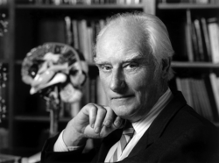
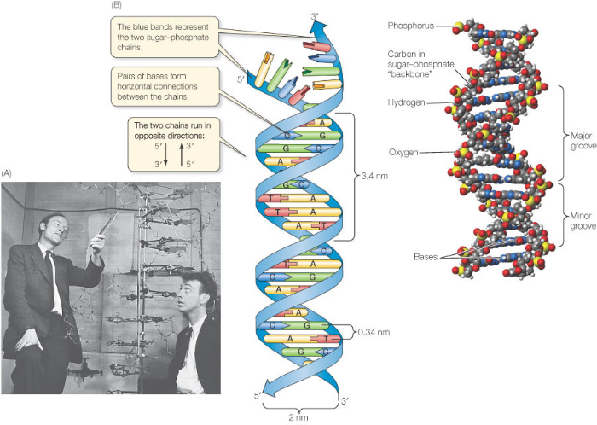
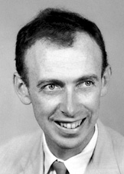
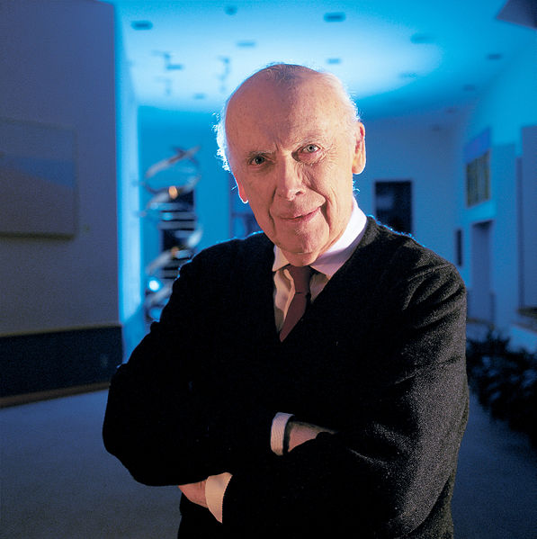
28 FEBRUARY 1953 : ANOTHER HISTORIC DAY FOR SCIENCE
F.Crick
(1916-2004)
Then
“This structure has novel features which are of considerable biological interest“………It has not escaped our notice that the specific pairing we have postulated immediately suggests a possible copying mechanism for the genetic material"
Watson and Crick in Nature, April 25, 1953
J.D.Watson
(1928- )
Now

Slide 8

“Three profoundly destabilizing scientific ideas ricochet through the twentieth century, trisecting it into three unequal parts: the atom, the byte, the gene. Each begins its life as a rather abstract scientific concept, but grows to invade multiple human discourses- thereby transforming culture, society, politics and language. But the most crucial parallel between the three ideas is conceptual: each represents the irreducible unit-the building block, the base organizational unit- of a larger whole: the atom of matter; the byte of digitized information and the gene, of heredity and biological information”

Slide 9
Science in pre-independent India

Slide 10
MISSED OPPORTUNITY FOR INDIAN SCIENCE
By the thirteenth century the free spirit of the western mind was adapting to hypothesis driven and evidence based scientific methods for exploring our physical and material world; however, the Indian mind had been enslaved by successive conquests by alien cultures. The age of reason and enlightenment bypassed us, both materially and literally.
India’s awakening
Long years ago we made a tryst with destiny, and now that time comes when we shall redeem our pledge, not wholly or in full measure, but very substantially. At the stroke of the midnight hour, when the world sleeps, India will awake to life and freedom. A moment comes, which comes but rarely in history, when we step out from the old to new, when an age ends, and when the soul of a nation, long suppressed, finds utterance.
Jawaharlal Nehru, Midnight August 14, 2017

Slide 11
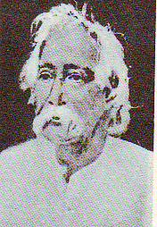
MAHENDRA LAL SARKAR ’S VIEWS ON INDIAN ASSOCIATION FOR THE CULTIVATION OF SCIENCE,ESTD 1876
“The sole function will be science-learning and science- teaching. We should carry on unaided by the (British) Government or more properly speaking, without seeking its aid. I want freedom for the institution. I want it to be solely native and purely National.”
“I reiterate my conviction that if our country is to advance at all and take rank with civilized nations, it can only be by means of science. To this end, I have given the best portion of my life, but I am sorry to leave this world with the impression that my labours have not met with the success it deserves.” ( Last letter, Nov. 1903)
Indian science was born by a deep sense of nationalism; to contribute to science was considered as a national service
1833-1904

Slide 12
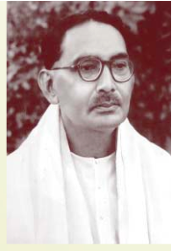
PROFESSOR NIL RATAN DHAR: ANOTHER STAUNCH NATIONALIST
Mentored by Acharya P. C. Ray, 1909
Founder of the discipline of Physical Chemistry in India
A staunch nationalist who believed in the power of evidence based science and science as a tool for nation building
1892-1986
“ I sincerely believe that sound progress of our nation depends essentially on science and its applications and I have preached this gospel for over 40 years. I am extremely keen on seeing Indian scientists taking up this matter of national regeneration through science with hard labour, great fortitude, devotion and sacrifice.”

Slide 13
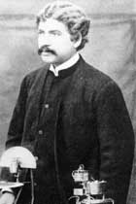
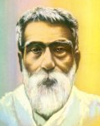
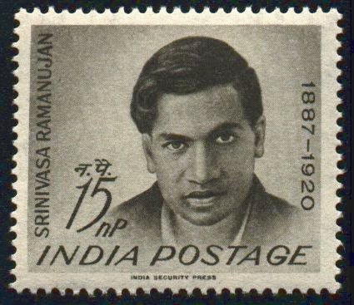
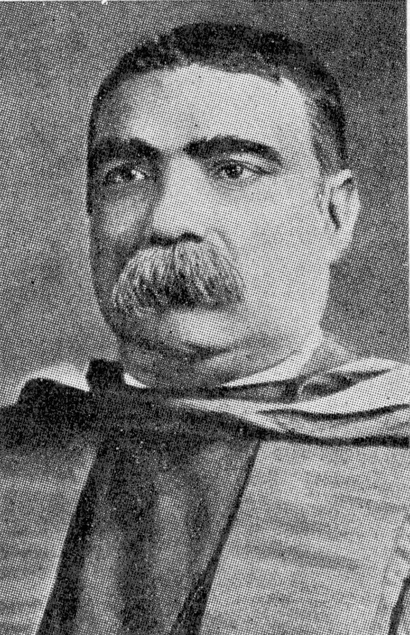
BEGINNINGS OF MODERN INDIAN SCIENCE
Asutosh Mukherjee (1864-1924)
First Indian to publish a paper (1881)
J. C. Bose (1858-1937)
Microwave communication, semiconductor
Missed the 1902 Nobel (Marconi)
“Satyagraha”: Salary boycott
P. C. Ray (1861-1944)
First to do research in Chemistry
Established Bengal Chemical and
Pharmaceuticals (1901)
S. Ramanujan (1887-1920)
FA fail (1908), First paper 1911, FRS (1918)

Slide 14









JEWELS OF INDIAN SCIENCE IN
PRE INDEPENDENCE PERIOD
C V Raman
S Ramanujan
Sir K S Krishnan
S N Bose
Sir M Visvesvaraya
J C Bose
Birbal Sahni
P C Ray
M N Saha

Slide 15

NEHRUVIAN GRAND VISION OF SCIENCE
“ I realized that science was not only a pleasant diversion and abstraction, but was of the very texture of life, without which our modern world would vanish away……..It was science alone that could solve these problems of hunger and poverty, of insanitation and illiteracy, of superstition and deadening custom and tradition, of vast resources running to waste, of a rich country inhabited by starving people.”
Indian Science Congress, Calcutta, 1938

Slide 16
Origins of modern scientific enterprise

Slide 17
THE ORIGINS OF MODERN SCIENCE
Scientific modernity began around 1700 with the publication of Isaac Newton’s publication of “Opticks”
This was the forerunner to the Age of Reason and the emergence of Enlightenment
Enlightenment provided an exalted view of human rationality and claimed that all individuals have the right as well as the power to shape their own destinies
This led to the emergence of rational scientific inquiry processes resulting in epoch making discoveries and eventually to the industrial revolution

Slide 18
MAN IN CONTROL OF HIS OWN DESTINY
I think; therefore, I am : Rene Descartes (1596-1650), Father of western philosophy and believer in rationalism
The Critique of Pure Reason: Immanuel Kant (1724-1804), Mind shapes our experience; proposed the concept of space and time as well as cause and effect
How we think (1910) ? : John Dewey(1859-1952), American philosopher and thinker who propagated the view that democracies encouraged free thought
Human individuals are the primary agent of creativity
You are that which you create : Don Reitz, American Sculptor 1920-2014

Slide 19
Science, technology and innovation are
social activities.
They can not be done in isolation and therefore, we can not disregard its history………History, if viewed as a repository
of more than anecdote or chronology, could produce a decisive transformation in the image of science in which we are now possessed.”
Thomas Kuhn
The Structure of Scientific Revolutions,
Fourth Edition, 2012
Thomas Kuhn defined the history of science in the mold of an evolution
The domain of the natural is not essentially different from the domain of the social

Slide 20
THE SOCIAL FUNCTION OF SCIENCE
( J.D. Bernal, George Rutledge and Sons, 1939)
Utility is the central objective of the scientific enterprise
Central role of state in supporting / promoting science
The rationale for organized science, government funded or directed science
Roger Pielke, Nature, 27 March 2014, Vol. 507, 427
The Sage of Science, A. Brown, Oxford University Press, 2007

Slide 21
THE ROMANTIC VIEW OF SCIENCE
Individual scientists pursuing truth leads to the most efficient social outcomes
Michael Polanyi
The Republic of Science : Its Economic Theory,
Minerva, I , 54 (1962
The intellectual debate between Bernal and Polanyi was one of the most engrossing debates of the second half of twentieth century!

Slide 22
THE ROMANTIC VIEW OF SCIENCE
“ Scientific research has to do only with the respect with which we regard one another, the dignity of men, our love of culture. It has to do with : are we good painters, good sculptors, great poets? I mean all the things we really venerate in our country and are patriotic about. It has nothing to do directly with defending our country except to make our country worth defending”
Robert Wilson, arguing for support from the US Congress for building the Fermi National Accelerator, 1969
Source: Scientific Temperament: Three Lives in Contemporary Science, P. J.Hilts, Holiday House, 1984

Slide 23
GOVERNMENT (PUBLIC) FUNDED RESEARCH IS OF A RECENT ORIGIN
State funding of research is a post world War II phenomena
A large part of nineteenth and twentieth century research and explorations in science were not funded by the state.
It was the two wars that gave impetus for the state to step in and direct research
No government funded research project on energy technology led to the discovery of steam engine or electricity, nor the discovery of automobiles and airplanes a programmed outcome of a structured approach to transportation technology !

Slide 24

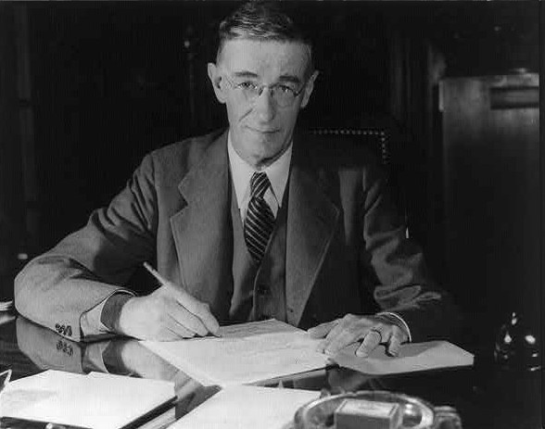
PUBLIC FUNDING OF SCIENCE : THE ORIGINS
The tenet : investment in “basic research” by a nation ”performed without thought of practical ends” will lead to prosperity for its people.
More money, more Institutions, more research, more papers and PhD’s will result in greater prosperity and wealth creation in society
This tenet was implicitly accepted by Governments around the world as an established public policy
1945
The Cold War fuelled large public investment in science driven by the military-industrial complex; with the collapse of the Communism, this rationale was lost

Slide 25
WHY SHOULD GOVERNMENT FUND SCIENCE ?
Economic growth and prosperity of a nation depends on investments in science ( Vannevar Bush’s hypothesis)
Science is too delicate or precious to leave it to non governmental sectors
Government intervention is necessary in S&T to prevent free market failures of emerging technologies
Government and the scientists who get funded have the best collective wisdom on the future strategic directions of science and technology
Politicians love to fund science; spend small money and take credit for large successes
It is patriotic to fund science ( like defending our borders)
Our country needs to produce more Noble Prize winners
Scientists love public funds, because it comes with no obligations other than to their own community

Slide 26
JUSTIFICATION FOR PUBLICLY FUNDED SCIENCE
Public funding of science provides a framework of theory and experimental data that places limits on available space for innovation
It creates human resources trained in critical inquiry
It supports innovation that are too risky for industry to pursue
Public funded research has led to a vast body of knowledge that lie at the foundation of all technologies
Science leading to solutions in areas such a new energy sources, public health, built habitats, environment, natural resource conservation and recycling will need public investments
It is perfectly reasonable to build an economic case for basic research. However, to realize value one needs practical and financial support to underpin training, networks and start up investment
M . Peplow, www.chemistryworld.org, August 2015
J. Stilgoe, The Guardian, October 26, 2015
V. Sivaram, The Newsweek, October 28, 2015

Slide 27
Science in Independent India : Evolution of public policies

Slide 28
POLITICAL AND ECONOMIC THOUGHT : EARLY YEARS OF INDIA’S INDEPENDENCE
State wielding “commanding heights” of the economy (Socialistic Pattern of Society)
State ownership of industries; Government’s ability to promote technologies in public enterprises
Control on import of processes, products and knowhow; regime of industrial licenses
Central planning as an instrument of public policy (The Soviet Model)
For a country gaining independence after almost four hundred years of external dominance, issues such as “self-reliance” and “indigenous development” of technology were the underlying basis of national pride, echoes of which we hear even today

Slide 29
BEYOND MERE PRACTICE OF SCIENCE : THE SCIENTIFIC TEMPER
Large numbers of people talk glibly about science today and yet in their lives or actions do not exhibit a trace of science.....But science is something more. It is a way of training the mind to look at life and the whole social structure...So I stress the need for the development of a scientific mind and temper which is more important than actual discovery as it is out of this temper and method that many more discoveries will come.
Jawaharlal Nehru,
Inaugural Speech ay the opening of National Physical Laboratory, New Delhi, January 1950
Nehru borrowed the concepts of “scientific thoughts” from Francis Bacon, John Stuart Mill and Bertrand Russell and gave it his own unique idiom

Slide 30
(It shall be the duty of every citizen of India) “ to develop the scientific temper, humanism and the spirit of inquiry and reform”
42nd Amendment Part IV-A Article 51-A
on Fundamental Duties to the Constitution of India, 1976
For Nehru the State was an instrument for building the scientific temper in the society; he assumed that the spread of education and research in S&T will embed the “scientific temper” in the lives of every Indian

Slide 31
SCIENCE IN INDIA POST 1950
Science in pre-independent India was predominantly individual science pursued within the confines of an University
State funding of science began in the early fifties. Emphasis was on creation of large R&D organizations to serve developments in industrial research (CSIR), atomic energy (BARC), space research(ISRO), agricultural research(ICAR), medical research (ICMR) etc.
In education, focus was on creating exclusive institutes for technology (IIT’s)
Education, originally a state subject, became a concurrent subject and federal government began to create central institutions. State Universities were left to the mercy of state funding

Slide 32


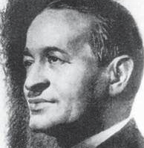
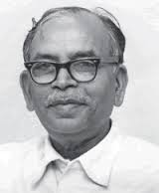
BUILDERS OF SCIENTIFIC INSTITUTIONS
NEHRU’S COMRADE-IN-ARMS
Dr. Homi Bhabha established the TIFR and BARC, leading to nuclear science and research. Today India has 14 reactors producing nearly 4000 MW electrical power
Professor Vikram Sarabhai’s space vision enabled India to acquire the capability to design, develop, build and launch any type of satellite from Indian soil. The recent journey of an Indian spacecraft to the orbit of Mars is a vindication of this vision
Professor Shanti Swarup Bhatnagar created multiple CSIR laboratories in various disciplines for developing technology for India’s industrial development
Dr D. S. Kothari created a chain of Defense R&D laboratories for promoting self-reliance in critical defense technologies.

Slide 33

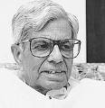

IMPACT OF S&T ON SOCIETY
Some noteworthy successes
The Green Revolution (Agriculture)
The White Revolution (Milk)
The Blue Revolution (Space)
The Grey Revolution ( IT and Communication)
Much of these transformations were a consequence of India’s post independence investment in S&T education and infrastructure

Slide 34
PUBLIC POLICIES ON SCIENCE AND TECHNOLOGY
Science Policy Resolution of 1958 (March 4, 1958)
Technology Policy Statement of 1983
Science and Technology Policy of 2003
Science, Technology and Innovation Policy 2013

Slide 35
POLITICAL AND ECONOMIC EVENTS THAT INFLUENCED INDIA’S SCIENCE POLICIES
The crisis of food, 1970
The first nuclear explosion at Pokharan, 18 May 1974 leading to wide spread sanctions and embargo on technology exports into India
The liberalization of economic policy, 1991
The era of coalition Governments, 1989 to 2014
The second nuclear explosion at Pokharan, 18 May 1998 leading to further economic sanctions
The National Action Plan on Climate Change and the Eight Missions, 2007

Slide 36
INDIA’S R&D INVESTMENTS
Rupees 800 billion
Rupees in Crores (10 million)
First formal R&D investment policy
Private Sector
R&D investment :
Rupees 300 billion
Plan period

Slide 37
INDIA SCIENCE INDICATORS
R&D investment as a % GDP (2011) : 0.88
Gross domestic expenditure on R&D : 42.8 billion US $ ( PPP, constant 2005 prices)
Gross expenditure on R&D per researcher : 201,800 US $ (PPP, 2013)
Number of researchers : 1,93,000
Total publications : 53,733 ( 4 % of global)
Patents granted per million population : 1.6 ( USA 160, UK 90, China 13, Russia 7.7)

Slide 38
RESEARCH SPENDING AND SCIENTIFIC PROWESS
Country | R&D as % GDP | GERD *, 2015 at PPP $ billion | Share of world GERD, % | GERD per researcher, PPP $ thousand, 2013 | Share of Publications, % | Researchers, lakh | Patents per million population
USA | 2.8 | 396.7 | 28.1 | 313.6 | 25.3 | 12.65 | 910
UK | 1.8 | - | - | - | 6.9 | 2.59 | -
Japan | - | - | - | - | 5.8 | 6.61 | 3,716
S.Korea | - | - | - | - | 4.0 | 3.22 | 4,451
Brazil | 1.2 | - | 2.2 | 210.5 | 2.9 | 1.39 | 34
China | 1.9 | 290 | 19.6 | 195.4 | 20.2 | 14.84 | 541
India | 0.9 | 42.8 | 3.2 | 201.8 | 4.2 | 1.93 | 17
Country
Gross Domestic Expenditure on R&D
Source : UNESCO Science Report, 2015; Nature, 2011, 2013 and 2015

Slide 39
R&D INSTITUTIONS AND NATIONAL INVESTMENT ON R&D ACTIVITIES (DSIR, 2007)
R&D Institutes | Number of institutions | Percentage of national investment on R&D (2003-04)
Central government R&D institutions | 707 | 62.6
Public sector institutions | 115 | 4.5
State government institutions | 834 | 8.5
Universities and institutions of National importance | 284 | 4.1
Private sector institutions | 2020 | 20.3
Total | 3960 | 100

Slide 40
GLOBAL RANKINGS : INDIA
Global Innovation Index (INSEAD), 2015 : 81
Global Competitiveness Index, 2016 : 50/142 ( USA 2, UK 10 , China 49)
Global Intellectual Property Index (University of Maastricht, NL): 7.05, 37/38
Bloomberg Innovation Index, 2016 : 45/50 ( S. Korea 1, Sweden 3, Singapore 6 and USA 8)
India has to transition from a “Factor” driven to “Efficiency” driven and ultimately “Innovation” driven economy

Slide 41
INDIA’S PUBLIC FUNDED S&T FOCUS SHIFTING TO TRANSLATIONAL RESEARCH
DBT : Commercialize public funded R&D; create TTO’s : 150; Technology and Business Incubators : 40
DST : Promote start ups and high risk as well as industry relevant research
CSIR : Align R&D with national missions, sanitation, cleaning of rivers, smart cities etc; 50 % of expenditure earn through external grants, licensing incomes and industry collaborations
Increasing pressures on publicly funded science to deliver solutions that benefit society

Slide 42
INDIA’S S&T IN THE NEXT DECADE
S&T operates within the framework of politics, economics and social fabric of a nation; India is changing rapidly in all these spheres
Resources will always be lesser than the demands of a growing economy.
Private sector will become increasingly more important; Government function will be limited to acting as regulators and facilitators, not gatekeepers
Government focus will remain limited to public health, water, sanitation, education, infrastructure, energy and national security.
In the economic sphere emphasis will be on manufacturing industries leading to creation of employment; However, much of “ come, make in India - sell anywhere” policy will be initially based on capital and technologies sourced from outside India
Funding for scientific research in public institutions will become more directed and even scarcer in the next few years. The dream run in increase in funding for S&T between 2000 and 2010 is unlikely to be repeated
Greater pressure to focus more on science that contributes to “nation building” and improve the “quality of life” of its citizens.
More questions are likely to be asked on how and where S&T is making an impact; merely stating that we are doing cutting edge, globally competitive science will not do !

Slide 43
Science in the 21st Century

Slide 44
SCIENCE IN THE 21st CENTURY
Scientific, technological and social trends are rapidly transforming the way we live and work
Technology is ubiquitous in the world we inhabit today; yet an average citizen has far little understanding of science and technology today than in the past
Public policy discourse has also tended to become biased, opinionated with selective dissemination of information
We all realize that science and technology have to provide answers to many critical problems that we face today; yet we do not have a coherent and shared vision of how we will accomplish this goal
A scientific order, philosophy and public policy that served us for over fifty years is now broken; there is a need to construct a new public policy framework that will defend future science

Slide 45
THE RISE AND FALL OF CORPORATE R&D
Corporate R&D flourished for over two centuries, ushering in the explosive growth of industries in Europe, Japan and America
DuPont, GE, GM, IBM, Exxon, Bell Labs, Kodak, Shell, BASF, ICI, Dow , Monsanto, Hoechst, Ciba, Bayer etc became great hub for science and technology.
Corporate R&D were large and diverse with a balance of curiosity and market driven programs . Industry had great execution and process skills .It attracted the best of talent ; Flory, Rochow, Knowles, Pederson, Davisson, Bardeen, Shockley, Penzias, Carothers, Langmuir, Hay , some of whom went on to win Nobel Prize.
Post nineties R&D restructured as part of SBU and funded by business; leadership transitioned from professional R&D managers who had cut their teeth in S&T to professional business managers
Corporate leadership came under increasing pressure to perform; time needed to recover investments in R&D became short.
Increasing input cost, globalization, faster technology diffusion, product commodatization, product liability, environment , health, safety and sustainability issues made investment in R&D more risky.

Slide 46
WE ARE STILL GRAPPLING WITH SEMANTICS !
Basic research
Fundamental research
Curiosity driven research
Directed basic research
Use inspired basic research
Translational research
Socially relevant research
Applied research
The lack of precision in the language of the scientists
is symptomatic of the lack of clarity on the nature of scientific enterprise

Slide 47
TRANSLATIONAL SCIENCE
Translational research is a way of thought about conducting scientific research to make the results of research applicable to population under study and is practiced in the natural, biological and social sciences (en.wikipedia.org/wiki/translational-research)
A term increasingly used in biology and medical science
Develop, design, engineer and produce/ commercialize: from bench to bedside
Translation of discoveries to applications was once the exclusive domain of industry
With industry stepping back, Government through public funding is increasingly stepping in to fill the vacuum, especially in high risk R&D
Success of translational efforts using public funds still not proven
The belief that public funds invested on needs identified by Government and focused on direct applications is the panacea for our ills goes against the lessons of history; Government picking technology winners is beset with great dangers and risks

Slide 48
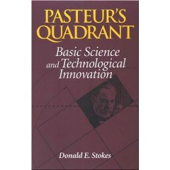
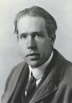


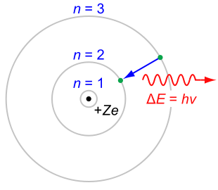

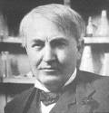

Pasteur's Quadrant
1997
Bohr
Pasteur
Fundamental Research
Edison
Use Inspired Research

Slide 49


BASIC AND APPLIED SCIENCE : ARE THEY DIFFERENT ?
Metaphor: Buckets of paint vs painting
There is science and the applications of science : Louis Pasteur
The emergence of concept of use inspired science
It means using basic science for a purpose and practical problems as stimulus to curiosity driven research ( G.W.Whitesides and J, Deutch, Nature 460, 21 (2011)

Slide 50
SCIENCE IN THE 21st CENTURY
Blue skies vs Directed Science
Small vs Big Science
Individual vs Team Science
Curiosity driven vs Grand Challenges or Utilitarian Science
Open access vs Intellectual Property

Slide 51
THE FUTURE OF SCIENCE
Science increasingly is interdisciplinary and cross functional
New paradigms in research funding; public funding increasingly tied to demonstrating measurable benefits to society
Turbulence on global economy and politics beset with income inequality, low growth, anti-intellectualism and oscillations between globalization and isolationism
An impatient citizenry, looking for quick solutions and increasingly aspiring for an “ideal” world, which may be beyond our reach
Science, technology and public policy is yet to come to terms with this new reality; we seem to be seeking solutions to future problems using old processes and methods

Slide 52
WHY SHOULD GOVERNMENT FUND SCIENCE ?
Economic growth and prosperity of a nation depends on investments in science ( Vannevar Bush’s hypothesis)
Science is too delicate or precious to leave it to non governmental sectors
Government intervention is necessary in S&T to prevent free market failures of emerging technologies
Government and the scientists who get funded have the best collective wisdom on the future strategic directions of science and technology
Politicians love to fund science; spend small money and take credit for large successes
It is patriotic to fund science ( like defending our borders)
Our country needs to produce more Noble Prize winners
Scientists love public funds, because it comes with no obligations other than to their own community

Slide 53
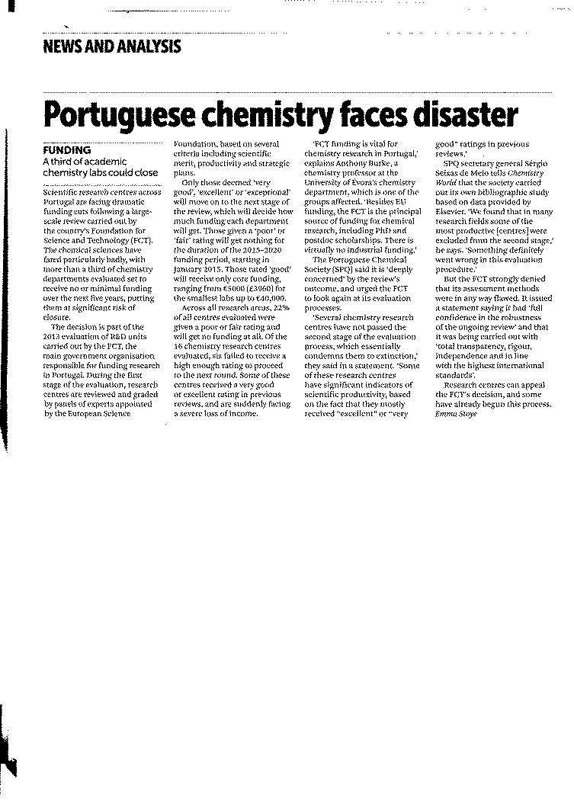
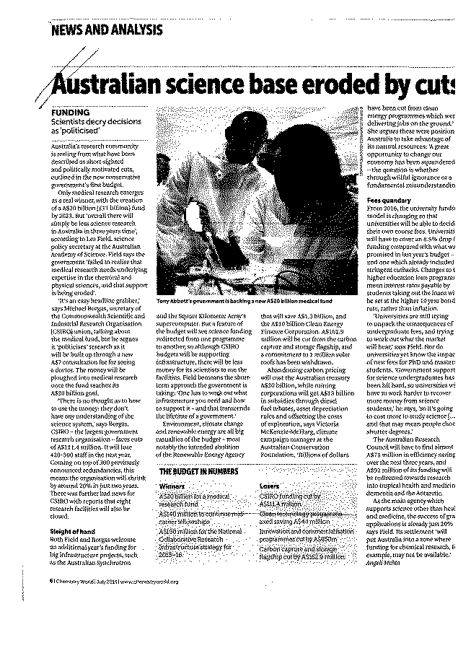
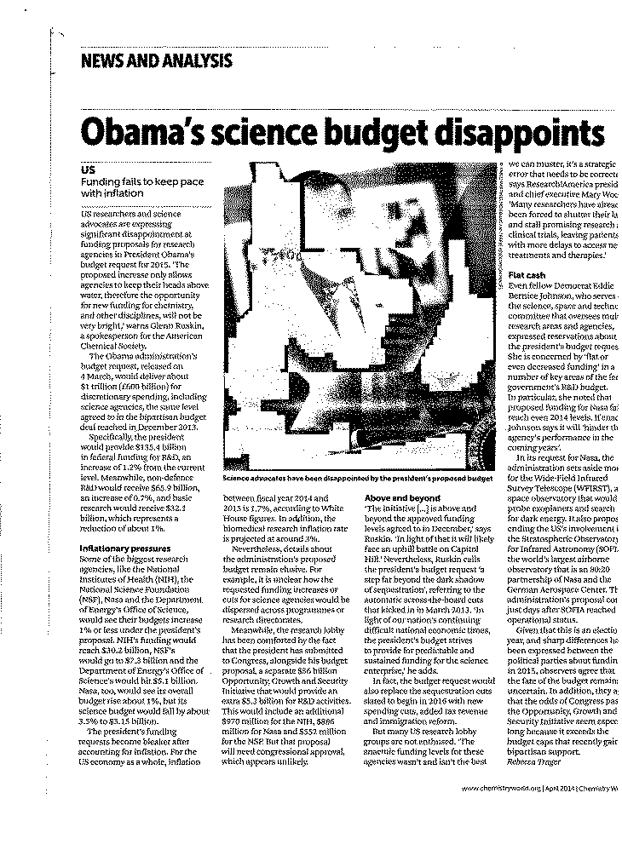
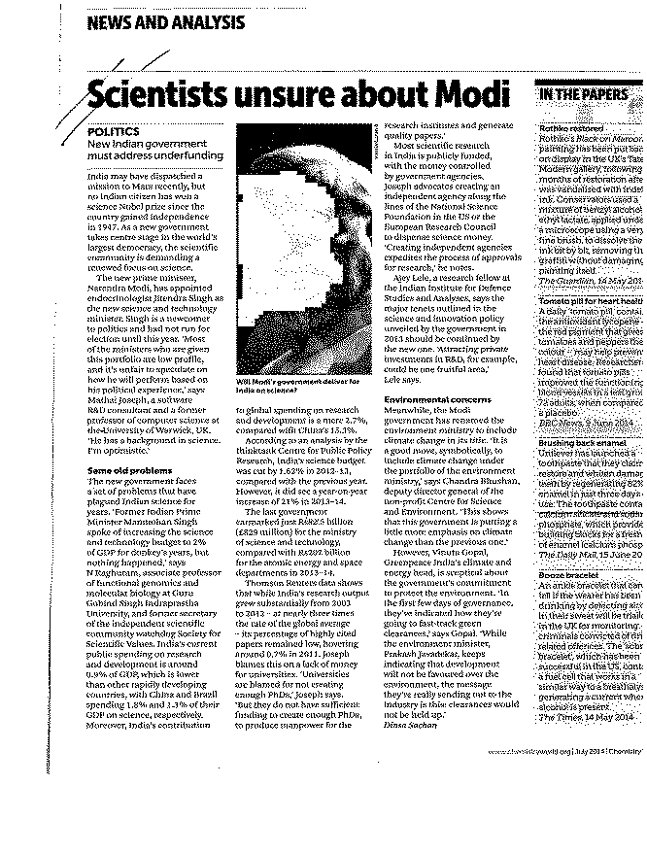
SCIENCE IN UNCERTAIN TIMES
Government funding of science under stress; In no country are the scientific community satisfied

Slide 54
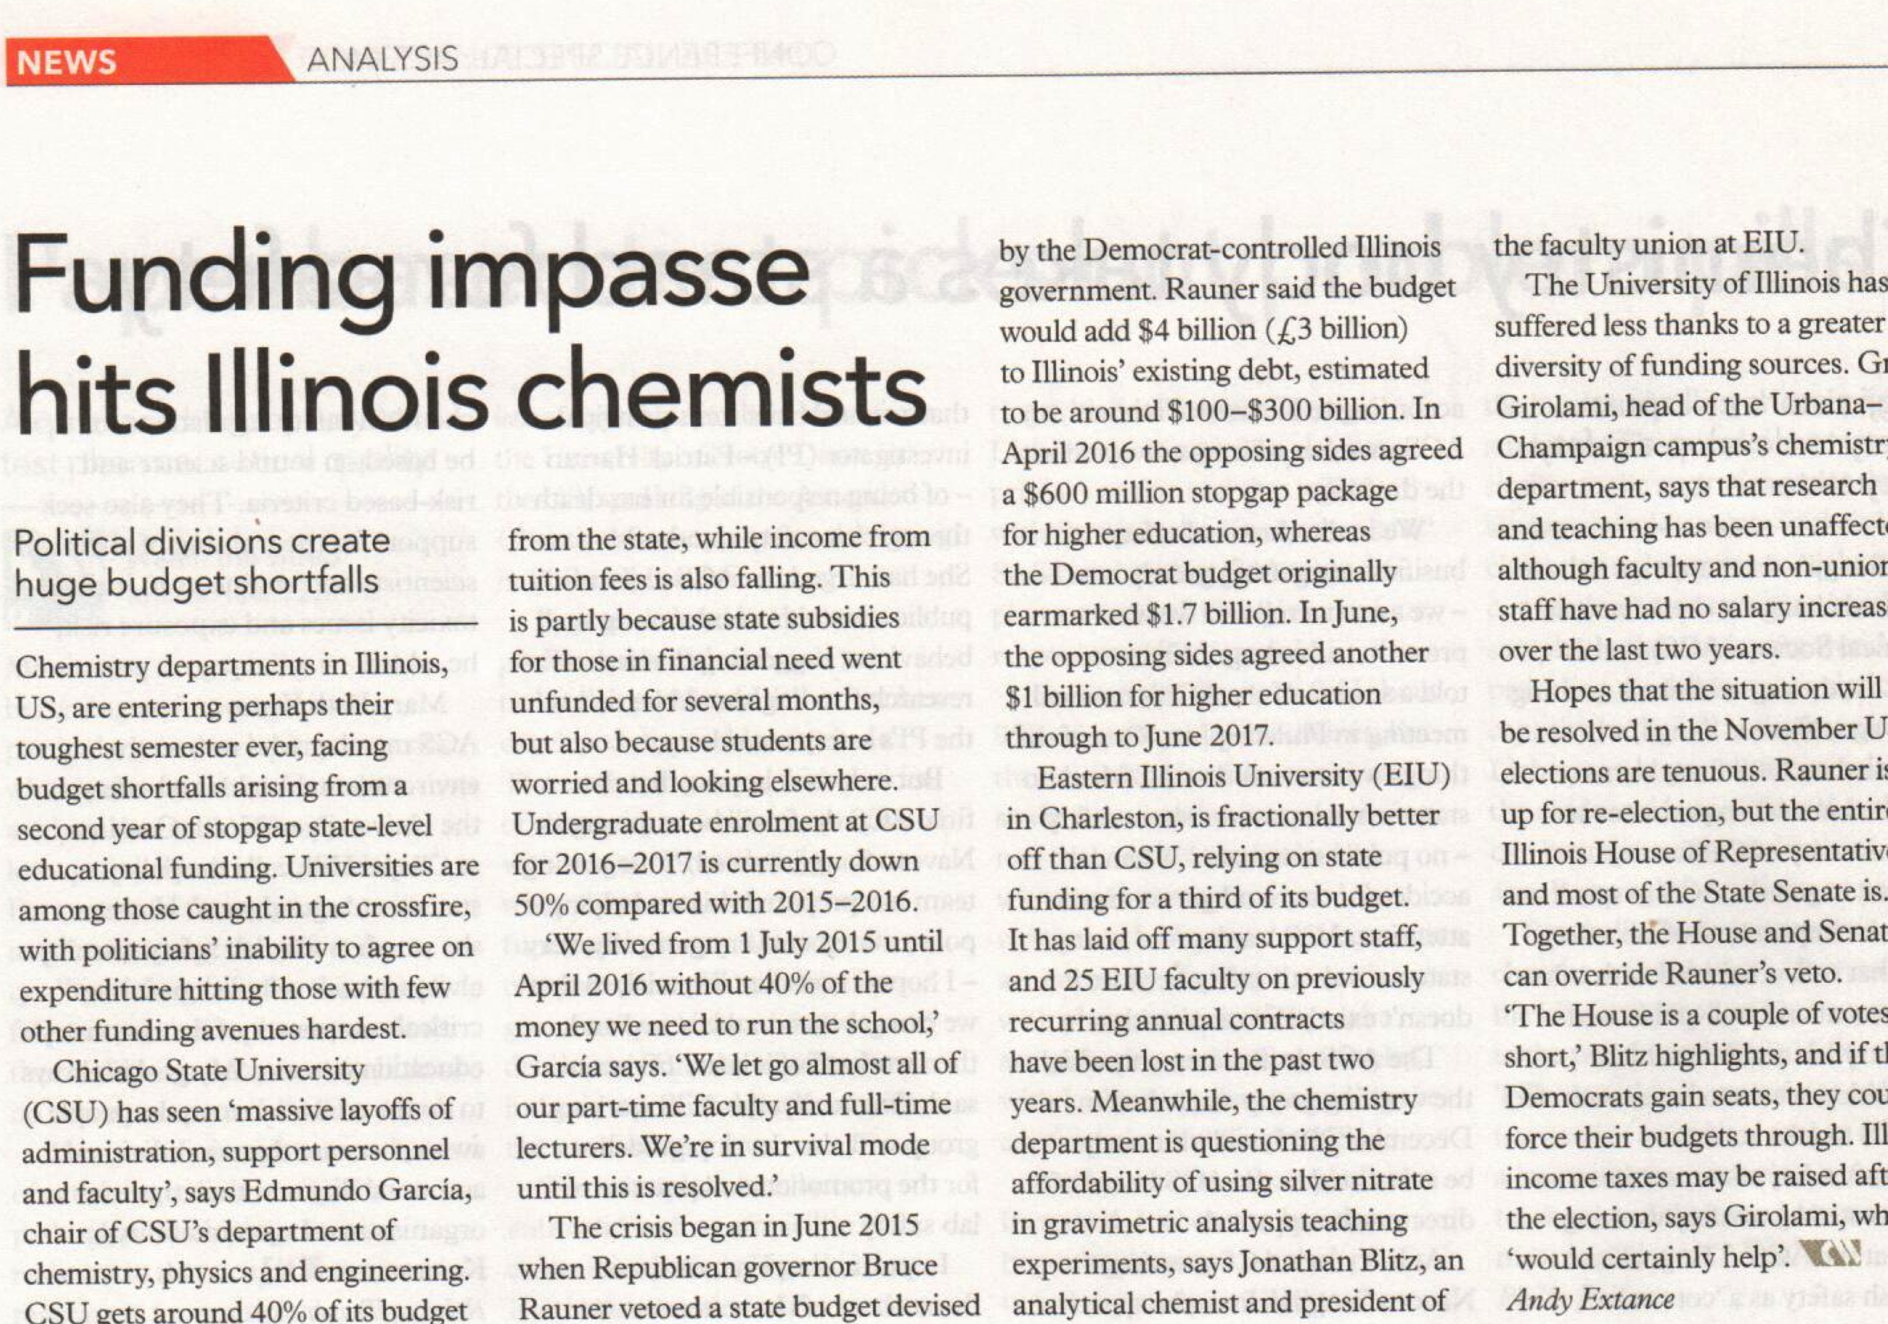
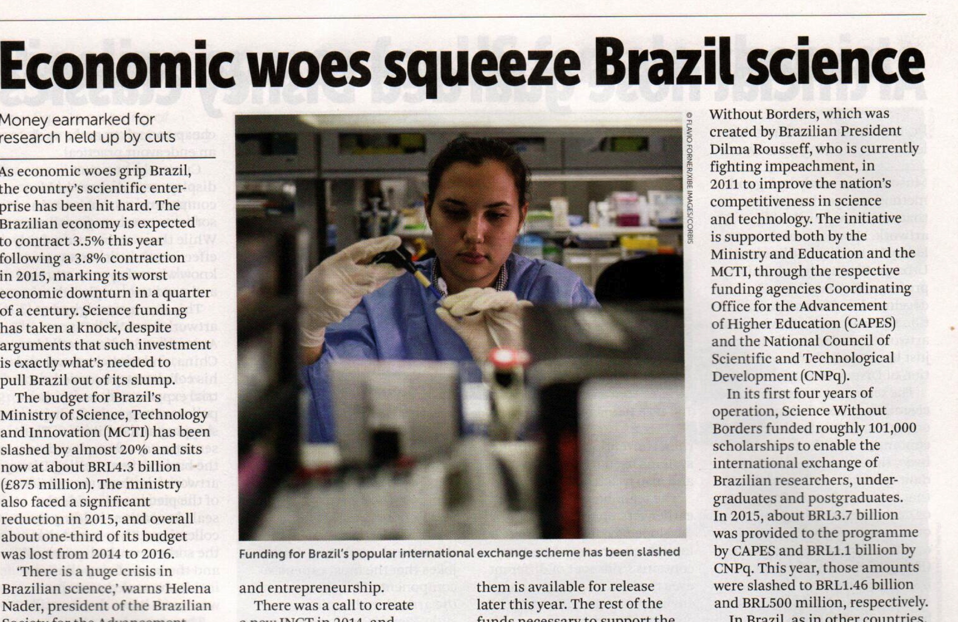
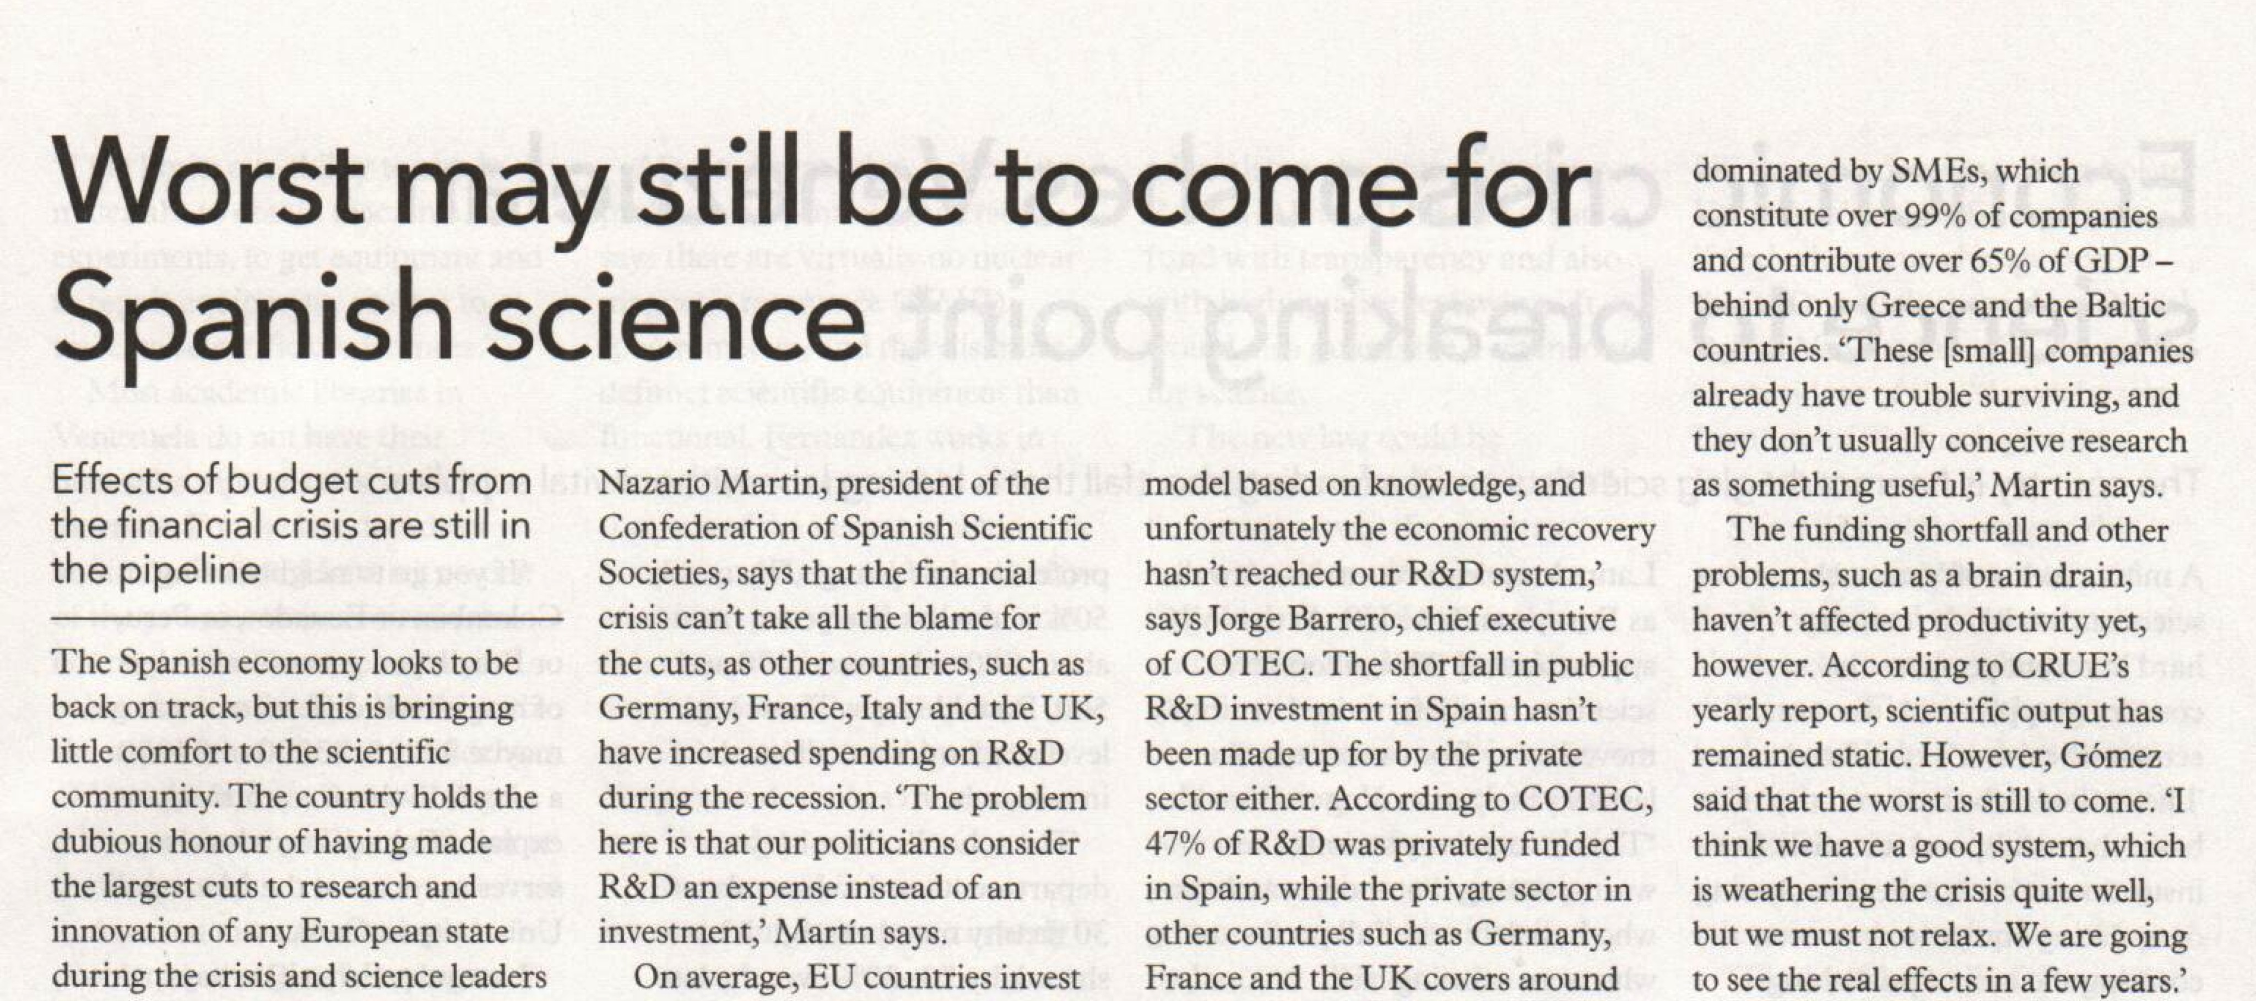
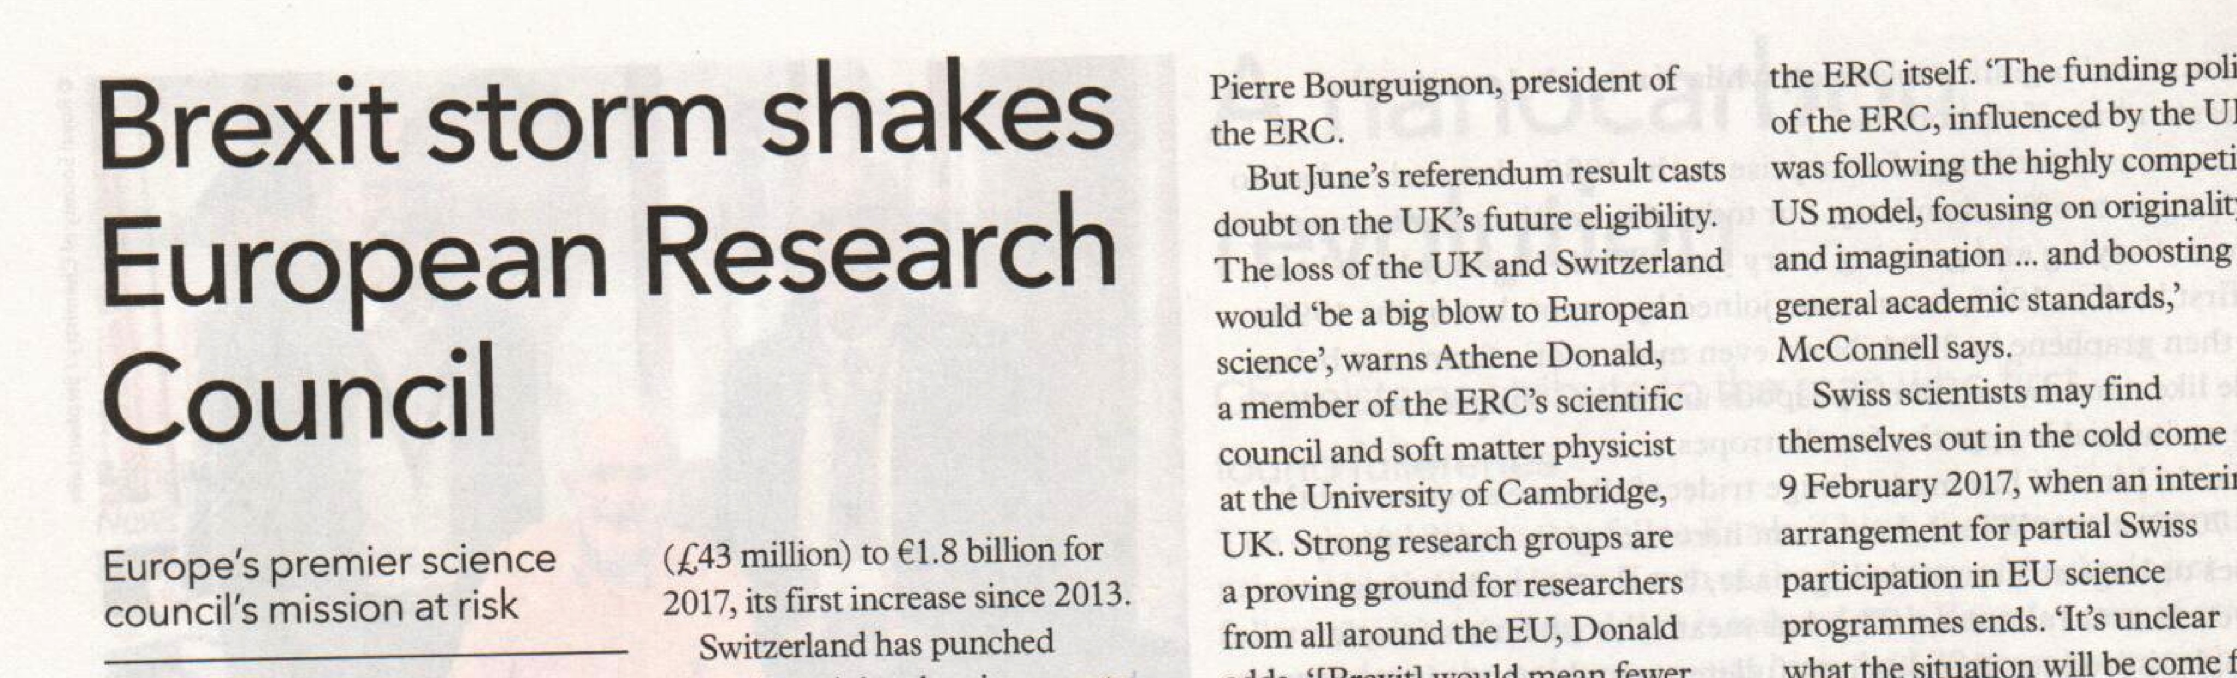
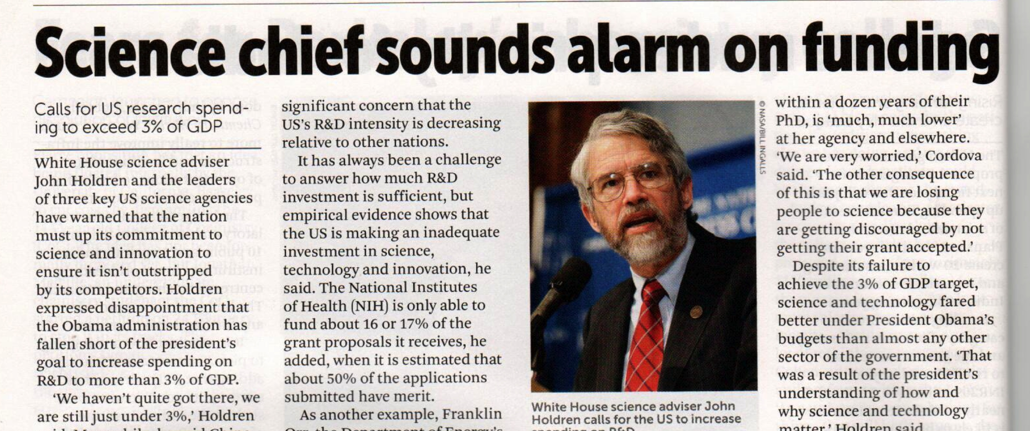
SCIENCE IN UNCERTAIN TIMES

Slide 55
WHAT THE FUTURE HOLDS ?
New ways of practicing science; where science is done, how knowledge is shared and how credit is assigned
Increased connectivity in the world of science driven by openness and real time collaboration
Changes in global demography and its impact on mobility and talent; how will nation compete to attract talent?
It is impossible to predict the future; we can either create it or prepare ourselves to face it

Slide 56
THE FUTURE OF SCIENCE FUNDING
Competing demands for public funding to meet the needs of a growing population and meet social objectives will limit spending on science
Public funding will be heavily focused on outcomes that tackle the immediate problems of society
Private funding of research will grow, not from industries, but from individuals, foundations, philanthropy, prizes and crowd sourcing; private institutes will be created for pursuing basic research
Consumers of research will become its funders
Will the original meaning of a research university supported by public funds become redundant? Will public funding be limited to only teaching and imparting skills?

Slide 57
IS PHILANTHROPHY AN ALTERNATIVE TO GOVERNMENT FUNDED SCIENCE ?
Science philanthropy is emerging as the biggest patron of big science, a third pillar along with the Government and the private sector
The donors are attempting to do what public funding of science has been less efficient at accomplishing; massive and guaranteed funding, greater freedom to the investigators to pursue risky ideas and fabulous research infrastructure
Pursuit of big science; high risk explorations with a long term payoff; escape from the vagaries of Government funding which is subject to political uncertainties and bureaucratic controls
There is both criticism and support for philanthropic funding of basic science
Will such funding skew research priorities, enrich elite universities, undermine political support for Government funded research ?
As a third pillar of funding of research, philanthropic funding is yet to be objectively assessed.
Entrepreneurship, new technologies and markets are throwing up increasing number of high net worth individuals, much quicker than ever before in the history of the world. Many of these individuals are driven by their desire for a lasting place in history.
“For better or worse the practice of science in the 21st century is becoming shaped less by national priorities or by peer-review groups and more by the particular preferences of individuals with huge amounts of money.”
Steven A. Edwards, American Association for the Advancement of Science

Slide 58
IS PHILANTHROPHY AN ALTERNATIVE TO GOVERNMENT FUNDED SCIENCE ?
Emergence of philanthropic funding of science
New Institutions
- Janelia Farm
- Allen Institute of Brain Sciences
- Broad Institute
- Welcome Trust
- Schmidt Ocean Institute
- Ellison Medical Foundation
- Bill and Melinda Gates Foundation
- Perimeter Institute of Theoretical Physics, Waterloo, etc
High net worth individuals/ not for profit entities
- Craig Venter( Celera)
- Elon Musk (Tesla)
- Gordon Moore
- Fred Kavli
- David Koch
- Kris Gopalakrishnan ( Brain Research Institute)
- Tata Trust ( IIT Mumbai), etc
William J. Broad, http://www.nytimes.com/2014/03/16/science/billionaires-with-big-ideas-are-privatizing-american-science.html?_r=0

Slide 59
DOES PUBLICLY FUNDED SCIENCE DRIVE INNOVATION ?
The linear model of pure science leading to applied science which in turn becomes useful technology is considered a myth by some
Are scientific breakthroughs cause or effect of technological change ?
Is there a relationship between public funding of science and economic development ?
Does public funding crowd out private funding?
Should the Government subsidize research for industry?
Is innovation an autonomous, self perpetuating process? Does technology find inventors or vice versa?
Is tinkering with existing technologies sufficient to produce “new” technologies?
Matt Ridley, Wall Street Journal, October 23, 2015

Slide 60
DOES PUBLIC INVESTMENT IN SCIENCE DRIVE ECONOMIC GROWTH?
US became a rich nation around 1900 when there was no state funding of science; the industrial revolution occurred without state funding
Much of twentieth century’s economic growth was the consequence of two World Wars
Economic activity is stimulated by privately funded research; Publicly funded research has no effect on economic growth (The Source of Economic Growth, OECD Report, 2013 )
Returns on publicly funded research is near zero
Between 1998 and 2003, the budget of US NIH doubled. What were the economic or health outcomes of this increased investment ?
GDP growth of a country has no correlation to its investment in S&T
Investment in science and engineering research boosts economic growth (CaSE, UK Report, Chemistry World, June 2014, p.9)
The integration of Vannevar Bush’s tenet with the economic theories of Joseph Schumpeter and Robert Solow in the early fifties led to the creation of the thought (or myth) that Government investment in R&D is critical to a nation’s growth
Terence Kealey, www.telegraph.co.uk/news/politics; Roger Pielke, http://thebreakthrough.org/index.php/voices/roger-pielke-jr/tall-tales-of-economic-growth/ ;
C.Macilwain, Nature, vol.495, 143, 13 March 2013

Slide 61
INDIA’S S&T IN THE NEXT DECADE
S&T operates within the framework of politics, economics and social fabric of a nation; India is changing rapidly in all these spheres
Resources will always be lesser than the demands of a growing economy.
Private sector will become increasingly more important; Government function will be limited to acting as regulators and facilitators, not gatekeepers
Government focus will remain limited to public health, water, sanitation, education, infrastructure, energy and national security.
In the economic sphere emphasis will be on manufacturing industries leading to creation of employment; However, much of “ come, make in India - sell anywhere” policy will be initially based on capital and technologies sourced from outside India
Funding for scientific research in public institutions will become more directed and even scarcer in the next few years. The dream run in increase in funding for S&T between 2000 and 2010 is unlikely to be repeated
Greater pressure to focus more on science that contributes to “nation building” and improve the “quality of life” of its citizens.
More questions are likely to be asked on how and where S&T is making an impact; merely stating that we are doing cutting edge, globally competitive science will not do !

Slide 62
IN CONCLUSION……….
The human race in the early part of 21st century is living in an unprecedented period of peace and prosperity. More people in the world have been lifted out of penury in the last quarter century, people are healthier, living better and longer. Many basic human needs have been fulfilled; So it is no wonder an average citizen’s interest in science and technology has also waned. He is no longer looking for “miracles of science”
This does not mean the world has no problems; environment, energy, global warming, climate change are issues that are threatening the long term survival of this planet. However, an average human mind cannot grasp issues that do not impact him in his own life time. To make a case for science for solutions that are needed in a distant future is no easy task !

Slide 63
Do the needs of the people served by the agenda and interests of modern science ?
Stories of impact of science on society is
becoming harder to tell; and the
important audience are increasingly
less inclined to listen
Nature, 23 February 2017, p.391

Slide 64
THANK YOU
for your patient listening

