Slide 1
ONE HUNDRED YEARS OF CHEMICAL BONDING: THE LIFE AND TIMES OF GILBERT NEWTON LEWIS
Royal Society of Chemistry, South India Local Section, Chennai
February 1, 2016
DR. S. SIVARAM
A 201, Polymers & Advanced Materials Laboratory,
National Chemical Laboratory, Pune, 411 008, INDIA
Tel : 0091 98607 99954 Fax : 0091 20 2590 2615 Email : s.sivaram@ncl.res.in
www.swaminathansivaram.in

Slide 2
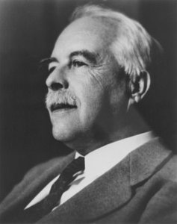
[CONTRIBUTION FROM THE CHEMICAL LABORATORY OF THE UNIVERSITY OF CALIFORNIA ]
THE ATOM AND THE MOLECULE.
BY GILBERT N. LEWIS.
Received January 26, 1916.
In a paper entitled “Valence and Tautomerism” l took occasion to point out the great importance of substituting for the conventional classification of chemical substances, as inorganic or organic, the more general classification which distinguishes between polar and nonpolar substances. The two classifications roughly coincide, since most inorganic substances are distinctly polar, while the majority of organic substances belong to the nonpolar class; thus potassium chloride represents the extreme polar type and methane the nonpolar. Nevertheless, there are many inorganic substances which, under ordinary circumstances, are predominantly nonpolar, and many organic substances which, at least in a certain part of the molecule, are strongly polar.
This article was apparently unknown to Sir. J. J. Thomson when he wrote, in 1914, an extremely interesting paper on the “Forces between Atoms and Chemical Affinity” in which he reached conclusions in striking accord with my own, and discussed in considerable detail the theories of atomic and molecular structure which led him to these conclusions.
To enable us to appreciate the importance and the usefulness of a distinction between the polar and nonpolar types of chemical molecules no hypotheses are necessary, but in a more minute examination of the nature of such a distinction some theory of structure is indispensable. Such a theory I have employed for a number of years in the interpretation of chemical phenomena, but it has not hitherto been published.
J. Amer. Chem Soc., 38, 762-785 (1916)
cited 1038 times
October 23, 1875
- March 23, 1946

Slide 3
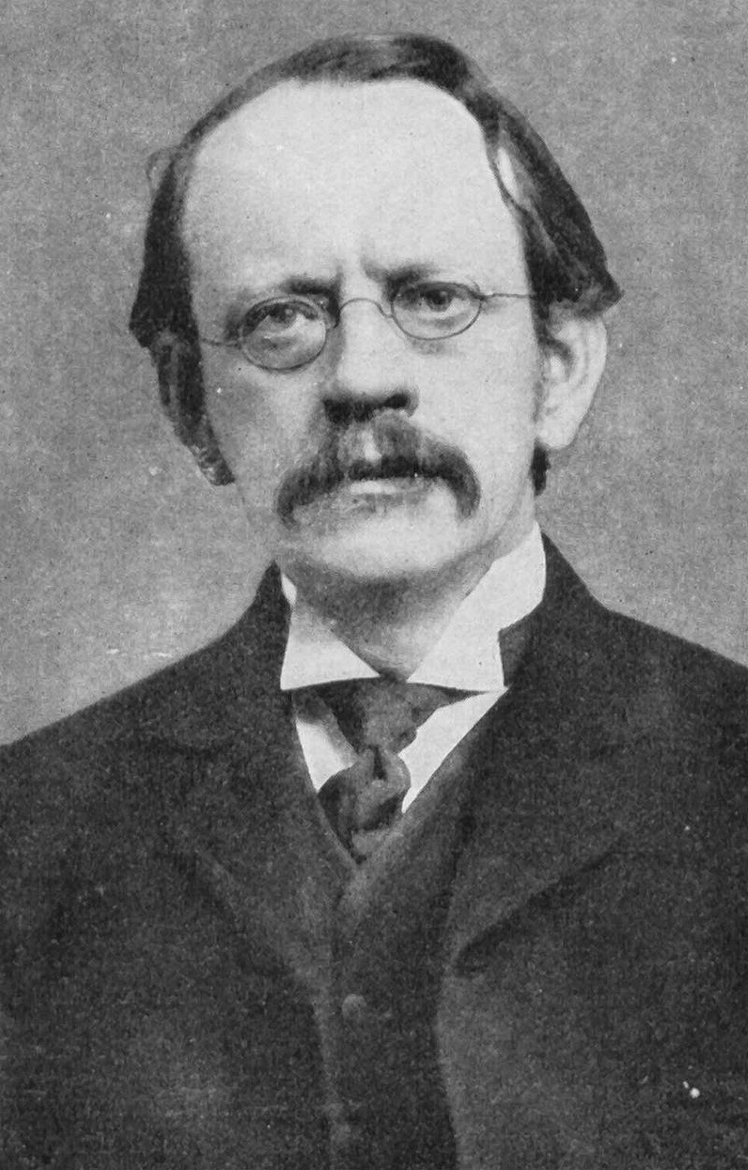
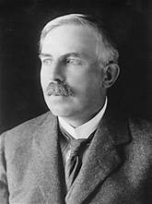
INQUIRY INTO THE NATURE OF ATOM
Lewis became interested in the nature of the atom very early in his career. His notebook of 1902 contains the first formulation of his theory, but he published nothing in this field until his interest was revived by the publication of a short article on the nature of bonds by W.C. Bray and G.E.K. Branch in 1913. This was followed almost immediately by a publication on the same subject by Lewis, and the revival of his ideas of 1902, which were thrown to the den of lions, the research conference. The theory was not published until three years afterwards, in 1916
J.J Thomson
Discovery of electron
Nobel, 1906
Ernest Rutherford
The model of the atom
Nobel, 1908
Niels Bohr
The structure of the atom
Nobel 1922

Slide 4
THE ORIGINS IN HIS OWN WORDS
“ In the year 1902 (while I was attempting to explain to an elementary class in chemistry some of the ideas involved in the periodic law) becoming interested in the new theory of the electron, and combining this idea with those which are implied in the periodic classification, I formed an idea of the inner structure of the atom which, although it contained certain crudities, I have ever since regarded as representing essentially the arrangement of electrons in the atom ... In accordance with the idea of Mendeleef, that hydrogen is the first member of a full period, I erroneously assumed helium to have a shell of eight electrons. Regarding the disposition in the positive charge which balanced the electrons in the neutral atom, my ideas were very vague; I believed I inclined at that time toward the idea that the positive charge was also made up of discrete particles, the localization of which determined the localization of the electrons “
Gilbert Newton Lewis, Valence and the Structure of Atoms and Molecules (1923), 29-30.

Slide 5
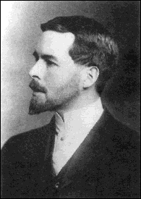
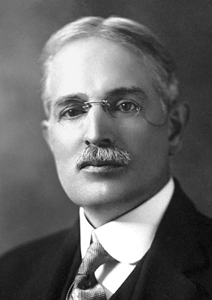
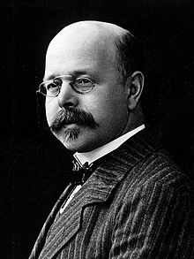
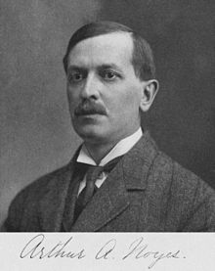
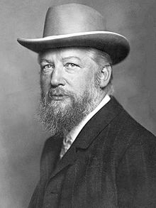
THE ACADEMIC GENEOLOGY OF G.N.LEWIS
Theodore Richards, Harvard University
1868-1928, Nobel, 1914
One of the first physical chemists in America, a student of Ostwald
PhD, 1897-99
G.N. Lewis
Walther Nernst, Gottingen
1864-1941, Nobel 1920
Wilhem Ostwald, Leipzig
1853-1932, Nobel 1909
Arthur Amos Noyes,
1866-1936, MIT and Caltech
1899-1900
1900-1901
1905-1912

Slide 6
THE MOVE FROM CAMBRIDGE , MASSACHUSETTS TO BERKELEY , CALIFORNIA
Lewis spent the period 1898-1904 at Harvard University. His scientific career post PhD at Harvard was ordinary and lacklustre
He felt stifled by the mentorship of Richards, a perfectionist who believed that students must be carefully supervised and treated them merely as his assistants
Lewis felt confined with little freedom of thought or action
After spending a year in Philippines as superintendent of weights and measures, he returned to the staff of MIT where he spent the years between 1905-12 in the laboratory for physical chemistry created by Arthur Amos Noyes. Contrary to Richards, Noyes was a hands off supervisor and open minded. Though trained as a classical physical chemist under Ostwald, he was receptive to the idea that molecules comprising atoms deserve consideration. Lewis bloomed and began his great contributions to thermodynamics and his early forays into chemical bonding during this period
His move to the west coast of the US was almost as if he wanted a clean break and escape from the traditions of Nernst and Ostwald who dominated the prevailing thoughts in physical chemistry. California, then, was a scientific backwater with no great schools of chemistry.
His move symbolized the yearning for freedom, from the dominant thoughts of the day, and an opportunity to break from the past.

Slide 7
PHYSICAL CHEMISTRY, CIRCA 1900
Physical chemistry was defined narrowly as problems of dilute solutions and the study of chemical processes
Nernst, Ostwald, Arrhenius, Van’t Hoff dominated the subject, often called “the ionists”
The first scientific journal for physical chemistry was started in 1887, Zeitschrift fur Physikalische Chemie
The discipline was borne out of a desire to confront the dominance of organic chemists of the day and as an antithesis to organic chemistry which dealt only with composition and structure
The objective of physical chemists was to study the science behind “the arrow” , the processes that determine chemical change. The goal was to shift chemistry from mere “taxonomy” to “analysis”
However, physical chemists rejected “atomism” and any talk of atoms and molecules was almost heretic
Wilhelm Ostwald drove a deep wedge between organic and physical chemistry, that continues to trouble chemistry even today
J. W. Servos, J. Chem. Edu., 61, 5, 1984

Slide 8
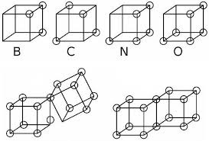
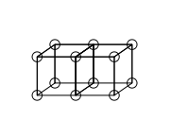
THE REVOLUTION IN CHEMISTRY
The “Lewis Dot” structure
Shared electron pair and and non polar chemical bond
The continuum between polar and non polar molecule
The theory of cubical atom; the corners of the cube represented electron positions
Outer shell electron varying between 0 and 8
Polar number and maximum valence number(Coordination number)
Odd and even molecule
Loose or odd electrons ( free radicals)
The cubical atom representation of Iodine
The oxygen atom
In spite of its apparent simplicity, the theory languished for almost a decade Why was this so ?

Slide 9
EVERY REVOLUTION IN SCIENCE BEGINS AS A FICTION
The physicists thought that the formalism lacked rigor (Niels Bohr, Arnold Sommerfield)
The static atom inherent in the model of Lewis was not acceptable to physicists who believed that the atom was dynamic
The organic chemists considered any theory that unifies of the nature of bonding in an organic and inorganic compound as blasphemous. They could not accept that structure of CH₄ and LiCl could be explained by the same theory ! The dogma of vitalism had still not vanished and any theory that unified organic chemistry and inorganic chemistry was not acceptable
Lewis’s ideas became acceptable only by the powerful articulation of Irving Langmuir and later with the emergence of quantum mechanics
Eventually and ironically, it would be the organic chemists who will embrace the models of Lewis, for it enabled them to explain the course of many chemical reactions that had long puzzled them. An understanding of structure and mechanism in organic chemistry owes a great deal to Lewis.

Slide 10
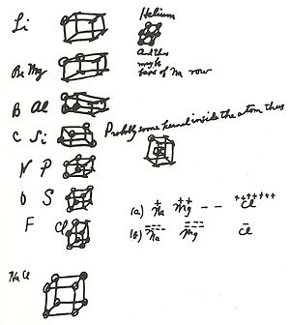
CONCEPTION TO DELIVERY : FIFTEEN YEARS
Lewis conceived his ideas of bonding while a PhD student at Harvard
Received no encouragement from his PhD mentor, Professor Richards
Professor Richards held the view that anything unobservable is not real and only good measurements can lead to good science. He called bonds, a crude method of representation of some facts about chemical reactions and a mode of representation is not an explanation. He believed that chemical bonds belonged to the realm of metaphysics
Lewis lecture notes, ca 1902
“ A few years later , I had very much the same idea of atomic and molecular structure as I now hold and had a great desire to expound them , but could not find a soul sufficiently interested in hearing the theory, There was a great deal of research being done ay the (Harvard) University, but as I see it the spirit of research was dead “
G. N. Lewis to Robert Mulliken, 28 October 1919

Slide 11
THE CUBICAL ATOM: RESOLUTION OF A DILEMMA
It was widely believed at that time ( and Lewis subscribed to this view) that two distinct type of bonds were required in chemistry, the polar electron transfer bond for ionic salts and some kind of non polar bond to represent non ionic organic compounds
Sometime between 1913 to 1916, Lewis was able to resolve his dilemma by using the cubical atom to arrive at the concept of shared electron pair bond which resulted in the “ simple assumption that the chemical bond is at all times and in all molecules merely a pair of electrons jointly held by two atoms”.
This removed the dichotomy of two distinct bond types “so repugnant to that chemical instinct which leads so irresistibly to the belief that all types of chemical union are essentially one and the same”
Yet, the cubical atom model was unable to represent a triple bond and Lewis realized that it needed further refinements

Slide 12
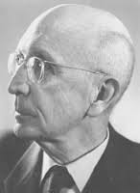
THE KOSSEL’S THEORY OF CHEMICAL BONDING
W. Kossell, Ann. Physik, 49, 229-362, 1916
Only the outermost electrons can participate in chemical bonding
“ In hydrogen molecule, two electrons occupy the same circular orbit in a plane perpendicular to the midline between the two nuclei and nitrogen molecule the two nuclei each with a pair of K electrons are held together by 10 electrons moving in the same circular orbit in the plane midway between the nuclei and the plane perpendicular to the intermolecular line”
January 4, 1988 – May 22, 1956
“ Comparison is often made of G. N. Lewis‘s paper and the paper by W. Kossel that was published in the same year. Kossel's paper (133 pages) was much longer than Lewis' (22 pages). Even so, I think that Kossel's paper represented no significant contribution. Much of it is nonsense. He gave a long discussion of electrostatic valence, but nothing about covalence, although he suggested electronic structures for some molecules in which the electrons were related to two nuclei”
Linus Pauling in J.Chem. Educ., 61(3), 203, 1984

Slide 13
LEWIS AND LANGMUIR: TWO CONTRASTING PERSONALITIES
Langmuir published a series of papers beginning 1919. The first was titled “ the arrangement of electrons in atoms and molecules”, J. Amer. Chem. Soc., 14, 868 and 1543, 1919.
Between 1919 to 1921, he published additional ten papers and delivered numerous lectures, extending, refining and popularizing Lewis’s concepts. While doing so he tacitly accepted Lewis’s concept of static atom
His postulates also were received with skepticism by the physicists as it violated some basic laws of physics
Langmuir introduced terms such as “electroneutrality”, “isoelectronic principle”, the “octet rule” and “covalent” bond
Langmuir was a superb communicator and a dynamic speaker. Although Lewis was initially pleased with the publicity his theory was receiving, he realized that with the passage of time, Langmuir was receiving most of the credit. This upset Lewis.
There is little doubt that Langmuir accelerated the acceptance of the Lewis electron pair bond amongst the chemical community and his personal reputation played a key part.
Langmuir was sauve, polished, diplomatic, discreet and one who meticulously cultivated his peers, both, on and off at work especially in Europe, everything that Lewis was not !

Slide 14
THE BOOK THAT GAVE LEWIS A PLACE IN HISTORY
The quintessential text book of chemistry for a generation of chemists till replaced by “ The Nature of Chemical Bond “ by Linus Pauling in 1935.
In the preface to this book, Lewis states
“ I had intended to present a more detailed manner the various facets of this subject but was interrupted by the exigencies of war. In the meantime the task was performed with far greater success than I could have achieved by Dr. Irving Langmuir, in a brilliant series of 12 articles and in a large number of lectures. It is largely through these papers and addresses that theory has received the wide attention of scientists. The theory has been designated in some quarters as the Lewis-Langmuir theory which would imply some sort of collaboration. As a matter of fact Dr. Langmiur’s work has been entirely independent and such additions he has made to what was stated in my paper should be credited to him alone”
Published 1923

Slide 15
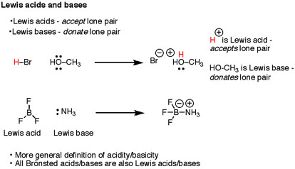
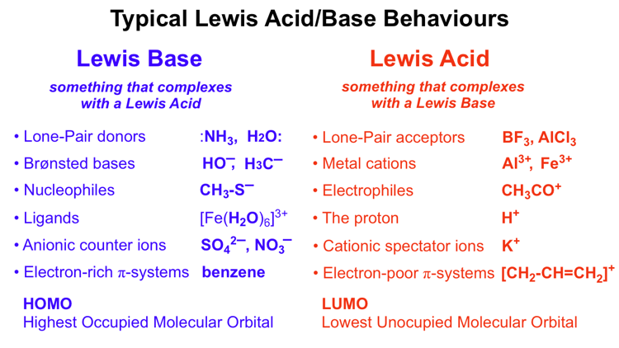
LEWIS ACIDS AND BASES (1938)

Slide 16
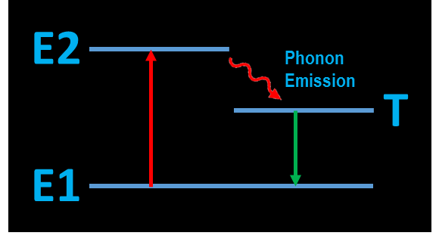
OTHER MAJOR CONTRIBUTIONS
Electron spin and magnetic moments (G.N. Lewis and L. Parson, 1915)
Interpreted thermodynamics in the language of chemistry; defined terms such as fugacity and activity; measurement of free energy and application of Gibbs free energy to chemistry; Thermodynamics and Free Energy of Chemical Substances, Lewis and Randall, 1923
Concept of distillation
The concept of photon as an unit of radiant energy
(Nature, 118, 874, 1926)
Understanding isotopes; first to produce D2O
(J. Chem. Phys., 1, 341, 1933)
Concepts of generalized acids and bases (J. Franklin Institute, 226, 293, 1938)
Origin of colour; the concept of extended “delocalization” of electrons over a large number of atoms (G.N Lewis and M.Calvin, Chem. Rev., 25, 273, 1939)
Phosphorescence and Fluoroscence; singlet and triplet state; paramagnetism of the phosphorescent triplet state (G. N. Lewis and M. Calvin, J.Amer.Chem.Soc.,67, 1232, 1945)
Lewis changed his research interests frequently, an evidence of his curious and wandering intellect
Jiffy : The time it takes light to travel 1 cm = ~ 3 x10⁻¹⁰ seconds

Slide 17
THE RELEVANCE OF TOOLS IN SCIENCE
“ It is one thing to learn an experimental method and apply with great exactness to all the problems which come to hand; it is another thing to have a definite problem which requires the use and often the invention of many different experimental methods”
G.N. Lewis to J. R. Partington, 7 December 1928

Slide 18
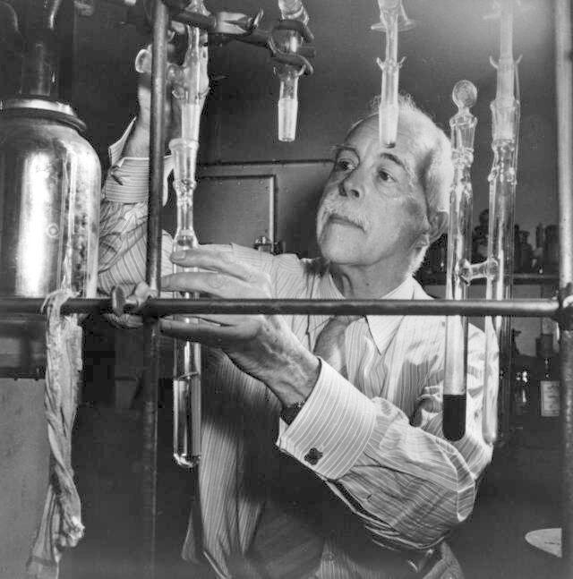
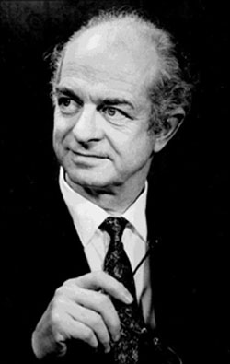
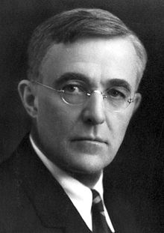
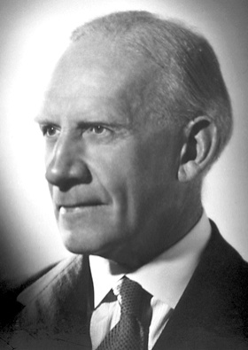
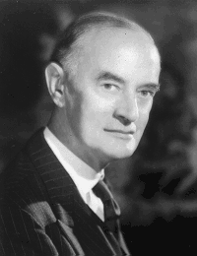
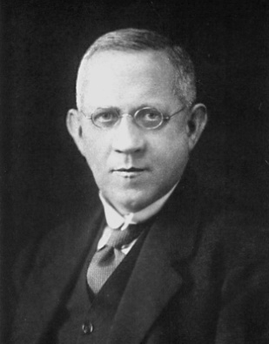
IMPACT OF LEWIS ON THE GROWTH OF CHEMISTRY
Linus Pauling
1901-1994
Advanced the understanding of chemical bond based on quantum mechanics
Irving Langmuir
1881-1957
Made Lewis’s concept acceptable
R. Robinson
1886-1975
C.K. Ingold
1893-1970
T. M. Lowry
1874-1936
Built the edifice of theory and mechanism in organic chemistry; the beginning of physical organic chemistry

Slide 19
G.N.LEWIS : AN INSTITUTION BUILDER
The Department of Chemistry at the University of California became one of the finest departments during 1912-1946, a centre of intense scientific activity
Three of his students won the Nobel; Urey in 1933, Seaborg in 1951 and Calvin in 1961;Two members of the faculty won the Nobel, Giauque, 1949 and Libby, 1960
He took less of the share of resources for himself, whether students or funds and gave more to his colleagues
Built a department without any divisions, either in organization or spirit; Lewis defined chemistry as a unitary science, not as organic, inorganic or physical
Freedom of expression with facts and logic reigning supreme over opinions and prejudices
Great teachers and leaders are those whose influence is multiplied by the many they have inspired

Slide 20
G.N. LEWIS : PERSONAL QUALITIES
Shunned crowd or public glare; poor social skills
Devoid of all pretentions and humble to the core
Not at ease in public speaking
A dislike for travel
Extraordinary literary skills
Iconoclastic and intolerance to humbug
Did not care much of applications of chemistry; Berkeley did not have a chemical engineering department as long as he was alive
Truculent, abrasive, unforgiving and bitter
Wide interests in chemistry, physics, mathematics; published papers in economics, biology of heavy water, the chemistry of stars, fundamental laws of matter and energy, principles of relativity and non Newtonian mechanics
He had a clear understanding of his place in history; he wanted to be an equivalent of a Newton or Einstein to Chemistry; not to be known as a mere physical chemist !

Slide 21
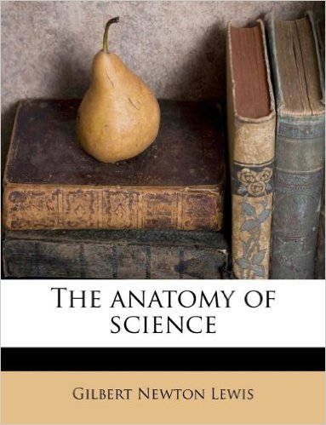
G.N.LEWIS : THE SCIENTIST PHILOSOPHER
“ I have no patience with attempts to identify science with measurement, which is but one of its tools, or with any definition of the scientist which would exclude a Darwin, a Pasteur or a Kekulé. The scientist is a practical man and his are practical aims. He does not seek the ultimate but the proximate. He does not speak of the last analysis but rather of the next approximation. His are not those beautiful structures so delicately designed that a single flaw may cause the collapse of the whole. The scientist builds slowly and with a gross but solid kind of masonry. If dissatisfied with any of his work, even if it be near the very foundations, he can replace that part without damage to the remainder. On the whole, he is satisfied with his work, for while science may never be wholly right it certainly is never wholly wrong; and it seems to be improving from decade to decade”
1926

Slide 22
G.N.LEWIS : THE SCIENTIST PHILOSOPHER
“ It must be admitted that science has its castes. The man whose chief apparatus is the differential equation looks down upon one who uses a galvanometer, and he in turn upon those who putter about with sticky and smelly things in test tubes. But all of these, and most biologists too, join together in their contempt for the pariah who, not through a glass darkly, but with keen unaided vision, observes the massing of a thundercloud on the horizon, the petal as it unfolds, or the swarming of a hive of bees. And yet sometimes I think that our laboratories are but little earthworks which men build about themselves, and whose puny tops too often conceal from view the Olympian heights; that we who work in these laboratories are but skilled artisans compared with the man who is able to observe, and to draw accurate deductions from the world about him “
Gilbert Newton Lewis, The Anatomy of Science (1926), 170- 1.

Slide 23
THE NOBEL THAT ELUDED LEWIS
Lewis was nominated a record 35 times for the Nobel between 1920-44, but died without winning the prize
He was not too pleased when Irving Langmuir won the Nobel in 1932
Was elected Fellow of the US National Academy of Sciences in 1913; resigned with out giving any reason in 1934; Was it triggered by the award of Noble to his former PhD student Harold Urey in 1933 for the discovery of Deuterium? After Urey’s Nobel, Lewis stopped all work on heavy water and did not publish a paper for eighteen months!
If he had lived longer, would he have shared the Nobel with Linus Pauling in 1954 “ for the nature of chemical bond” ? Or perhaps with Giauque in 1949 for chemical thermodynamics ?
He was passed over by the Nobel Committee repeatedly several times. He was nominated for his work on thermodynamics, shared electron pair bond, discovery of heavy water and for the study of fluorescence and phosphorescence. His nominations did not find support at various times from referees , such as, Arrheinius, Svedberg , Nernst (or his friends), Ramberg, and Fredga .

Slide 24
LEWIS DIES IN HARNESS IN HIS LABORATORY
Lewis dies suddenly on the afternoon of Saturday, March 23, 1946 while performing an experiment with liquid hydrogen cyanide in the laboratory. He was 70 years old
Official cause of death : Coronary artery failure
Just before he came to the laboratory, Lewis had a lunch engagement with Irving Langmuir, one of his bitterest rivals
People who met him after the lunch found him in a somber mood; what transpired during lunch is a mystery
By the end of his life, Lewis was a bitter man. He saw men who built on his scientific discoveries walking away with honors, which he felt was rightfully his. He could not reconcile to the thought that he was a lesser mortal
Try and teach your students to be generous, to be honest, to give other people credit and do not expect any prizes – because you are not likely to get them
M. Kasha, Lesson from Lewis’s life

Slide 25
LESSONS FROM THE LIFE OF G. N. LEWIS
Confront a reader with a surprising paradox
Preview literature based on own analysis without an extensive literature review ; extensive knowledge of the literature (review) before doing research could stifle originality
Ask a small question and from that answer derive a larger idea
Look for simplicity in theory and experiments; truth is often very simple
Design elementary experiments, but extract maximum information from them
Cultivate wide interests; major discoveries lie at the interface of disciplines
Have the courage to question the dominant logic or thought; nothing in science is the “whole truth”
Imagination and intuition is more important than intelligence and information
Self promotion may be necessary if one has to achieve scientific recognition

Slide 26
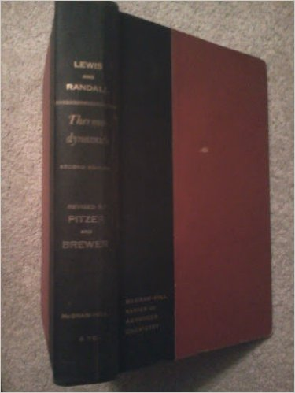
A GREAT ARCHITECT OF CHEMISTRY
But sometimes we enter (a cathedral) that is still partly under construction; then the sound of hammers, the reek of tobacco, the trivial jests bandied by workmen, enable us to realize that great structures are but the result of giving to ordinary human effort a direction and purpose. Science has its cathedrals, built by the efforts of a few architects and many workers…..”
Preface, ‘Thermodynamics and the Free Energy of Chemical Substances” co-authored with Randall (1923)
There are only two ways you can be remembered long after you are gone. Do something which others will write about or write something which others will read
Benjamin Franklin

Slide 27
FURTHER READING
Proceedings of the G. N. Lewis Symposium, ACS Meeting, Las Vegas, 1982 in the Journal of Chemical Education, 61, issues 1 to 3, 1984
M. Kasha, Four great personalities of science, G.N. Lewis, J. Franck, R.S. Mulliken and A. Szent-Gyorgyi, Pure and Applied Chemistry, 62(8), 1615, 1990
Cathedrals of Science : The personalities and rivalries that made modern chemistry, P. Coffey, Oxford University Press, 2008
M. Sutton, Chemistry World, p.59, January 2016

Slide 28
THANK YOU

